Slide 1
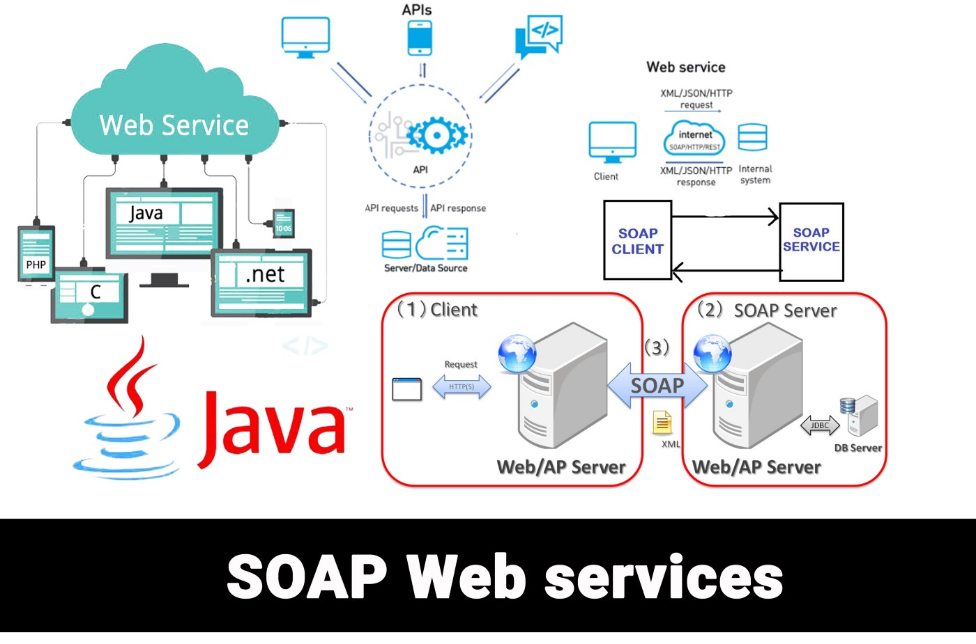
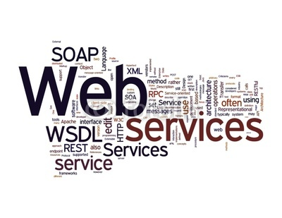


Building Own Web Services using SOAP and SOA Architecture
Fathima Mirza, Otabek Sobirov, Mohammad Newaj Jamil, Md Abu Ahammed Babu
Conclusions
Use pictures or illustrations! Make sure that every figure, table and picture has a caption that describes what is being shown. All text should be horizontal, not vertical. Image caption: Arial regular
SOA & SOAP
Service-Oriented Architecture (SOA) consists of three basic components:
1. Service provider
2. Service broker
3. Service requestor
Simple Object Access Protocol (SOAP) is an XML based protocol for accessing web services over HTTP
Advantages of SOAP
A light weight protocol used for data interchange between applications
It uses XML which is a light process of data exchange
It is designed to be platform independent
It works on the HTTP protocol which is default for all web applications
Use diagrams to illustrate your results. Arial regular
Tips:
The best font for text blocks that are as short as they should be on a poster is a sans serif typeface family. Therefore, use fonts such as Arial or Mundo sans rather than serif fonts like Times.
AVOID CAPITAL LETTERS IN TEXTS THAT ARE LONGER THAN ONE LINE, SINCE THEY ARE MORE DIFFICULT TO READ.
Drawbacks of SOAP
Only XML format can be used.
SOAP is slow because the payload is in XML which requires complex parsing & transformations.
Whenever there is a change in the server-side, the client stub classes need to be generated again.
Handouts
If you succeed in getting the reader's attention, provide her/him with more detailed information in the form of handouts or printed articles. Include references on your handout instead of the poster.
Write some short notes of what’s going on in the future. Place handouts, business cards, reprints nearby the poster.
References:

